Slide 1
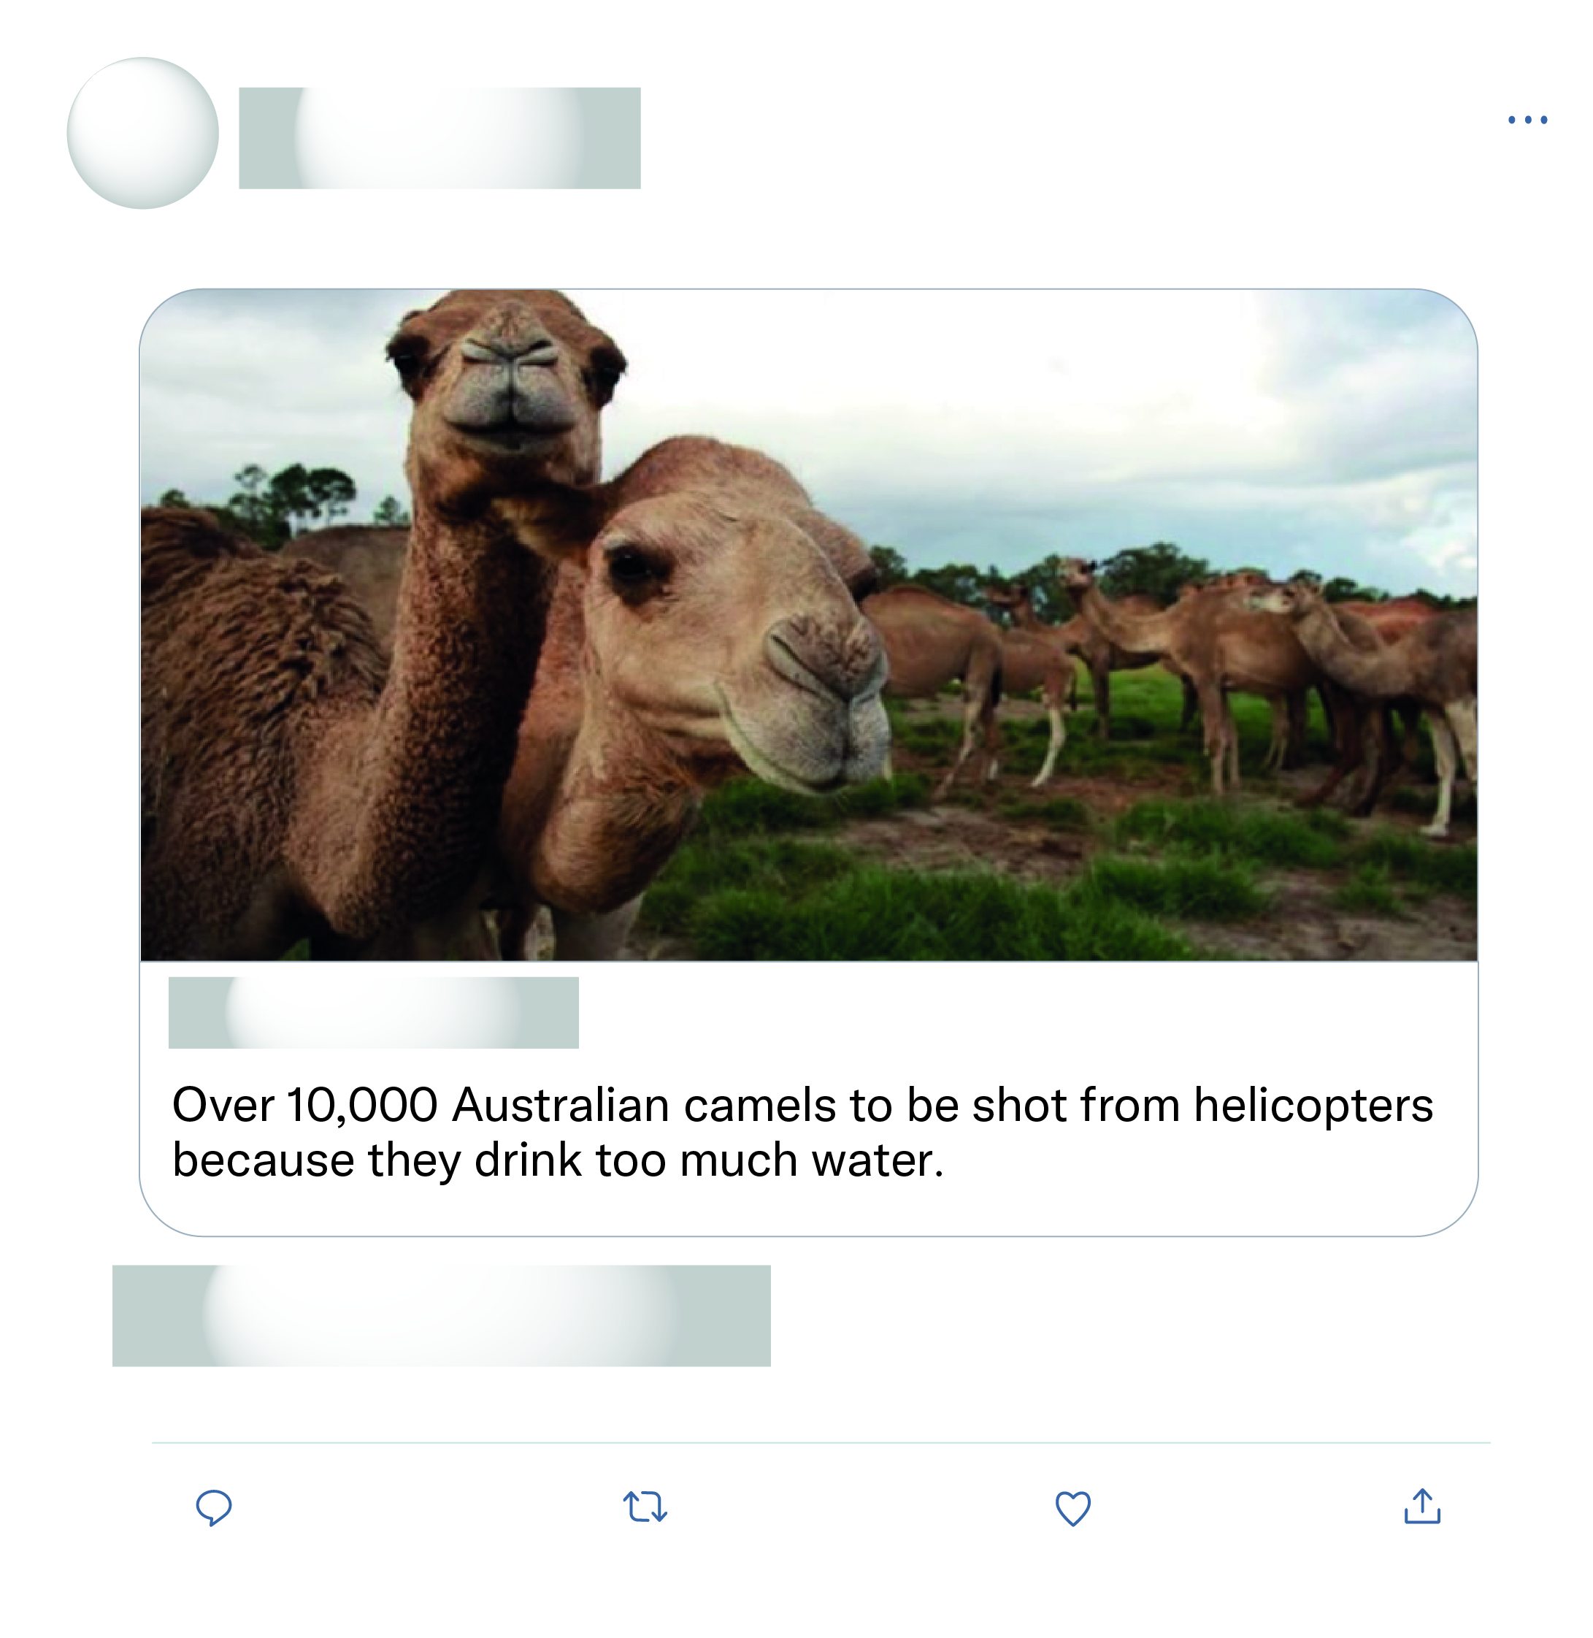








That's all the experts sat down and discussed as the solution wow what a productive move nothing else just killing more animals again after half a billion have died what a move.
This is just absolute nonsense!

Slide 2
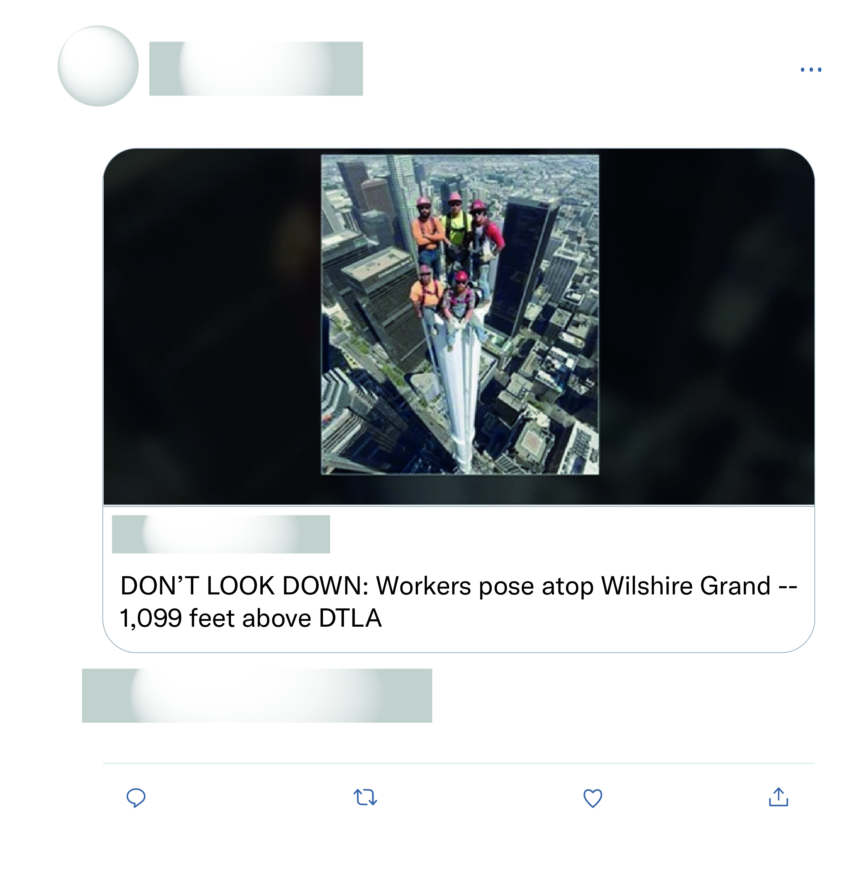
Well this is certainly a photoshop. Very creative nevertheless!
I don't believe it. To me looks photoshop or whatever it's called! Lol
Looks fake from top to bottom. Cool picture though.
Photoshopped!

